Slide 1

WEEK 12 REAL – TIME dashboards lecture
Instructor: Yanan Wu
fALL 2025

Slide 2
12.1 ARCGIS DASHBOARD

Slide 3
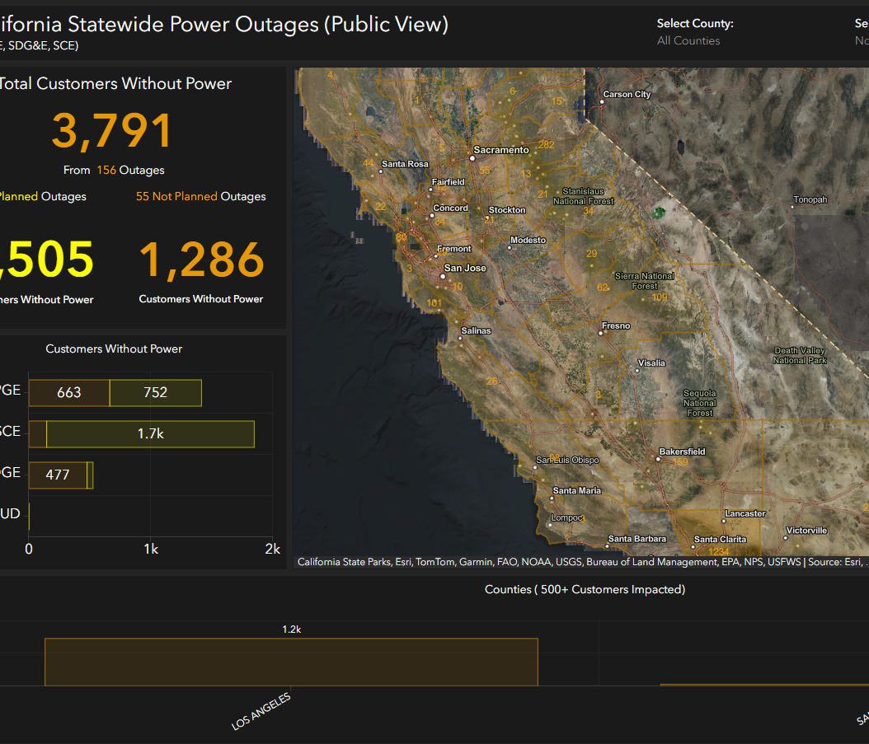
Arcgis dashboard gallery
https://www.arcgis.com/apps/dashboards/7edefc1970d44b839ebbfd7b45e51e2d

Slide 4
Real-time data in arcgis dashboard
Get Data
Dalals GIS Data Portal
Data Cleaning
Inspection
Delete
Publish
Publish data to ArcGIS Online
Manipulate
Compose
Integrate Data to Dashboard
Share
Share with Public

Slide 5
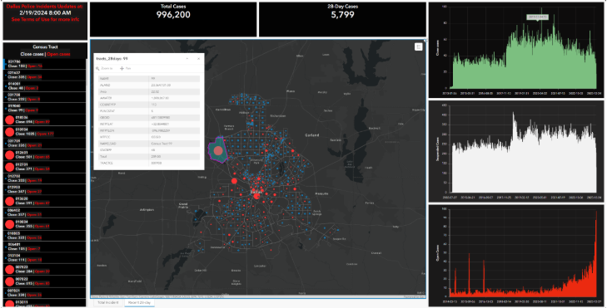
POLICE INCIDENTS PROJECT

Slide 6
12.2 data

Slide 7
dATA
Police Incidents Data
Shapefile, Feature Class/Service.
CSV (lat/long).
API (JSON).

Slide 8
Pros and cons of data
Shapefile, Feature Class/Service.
GIS – Ready format
Need GIS knowledge to process data
CSV (lat/long).
Easy to understand
Can take a long time to download large datasets
API (JSON).
Easy to download and filter data dynamically
Need Programming Skills

Slide 9
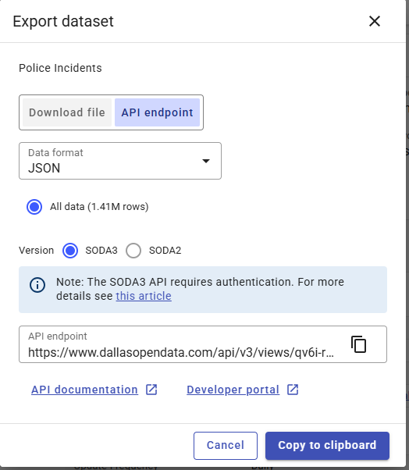
Practice 1: get data using api
What is the difference between SODA3 and SODA2?
Check the structure of JSON file from API endpoint

Slide 10
12.2 data cleaning

Slide 11
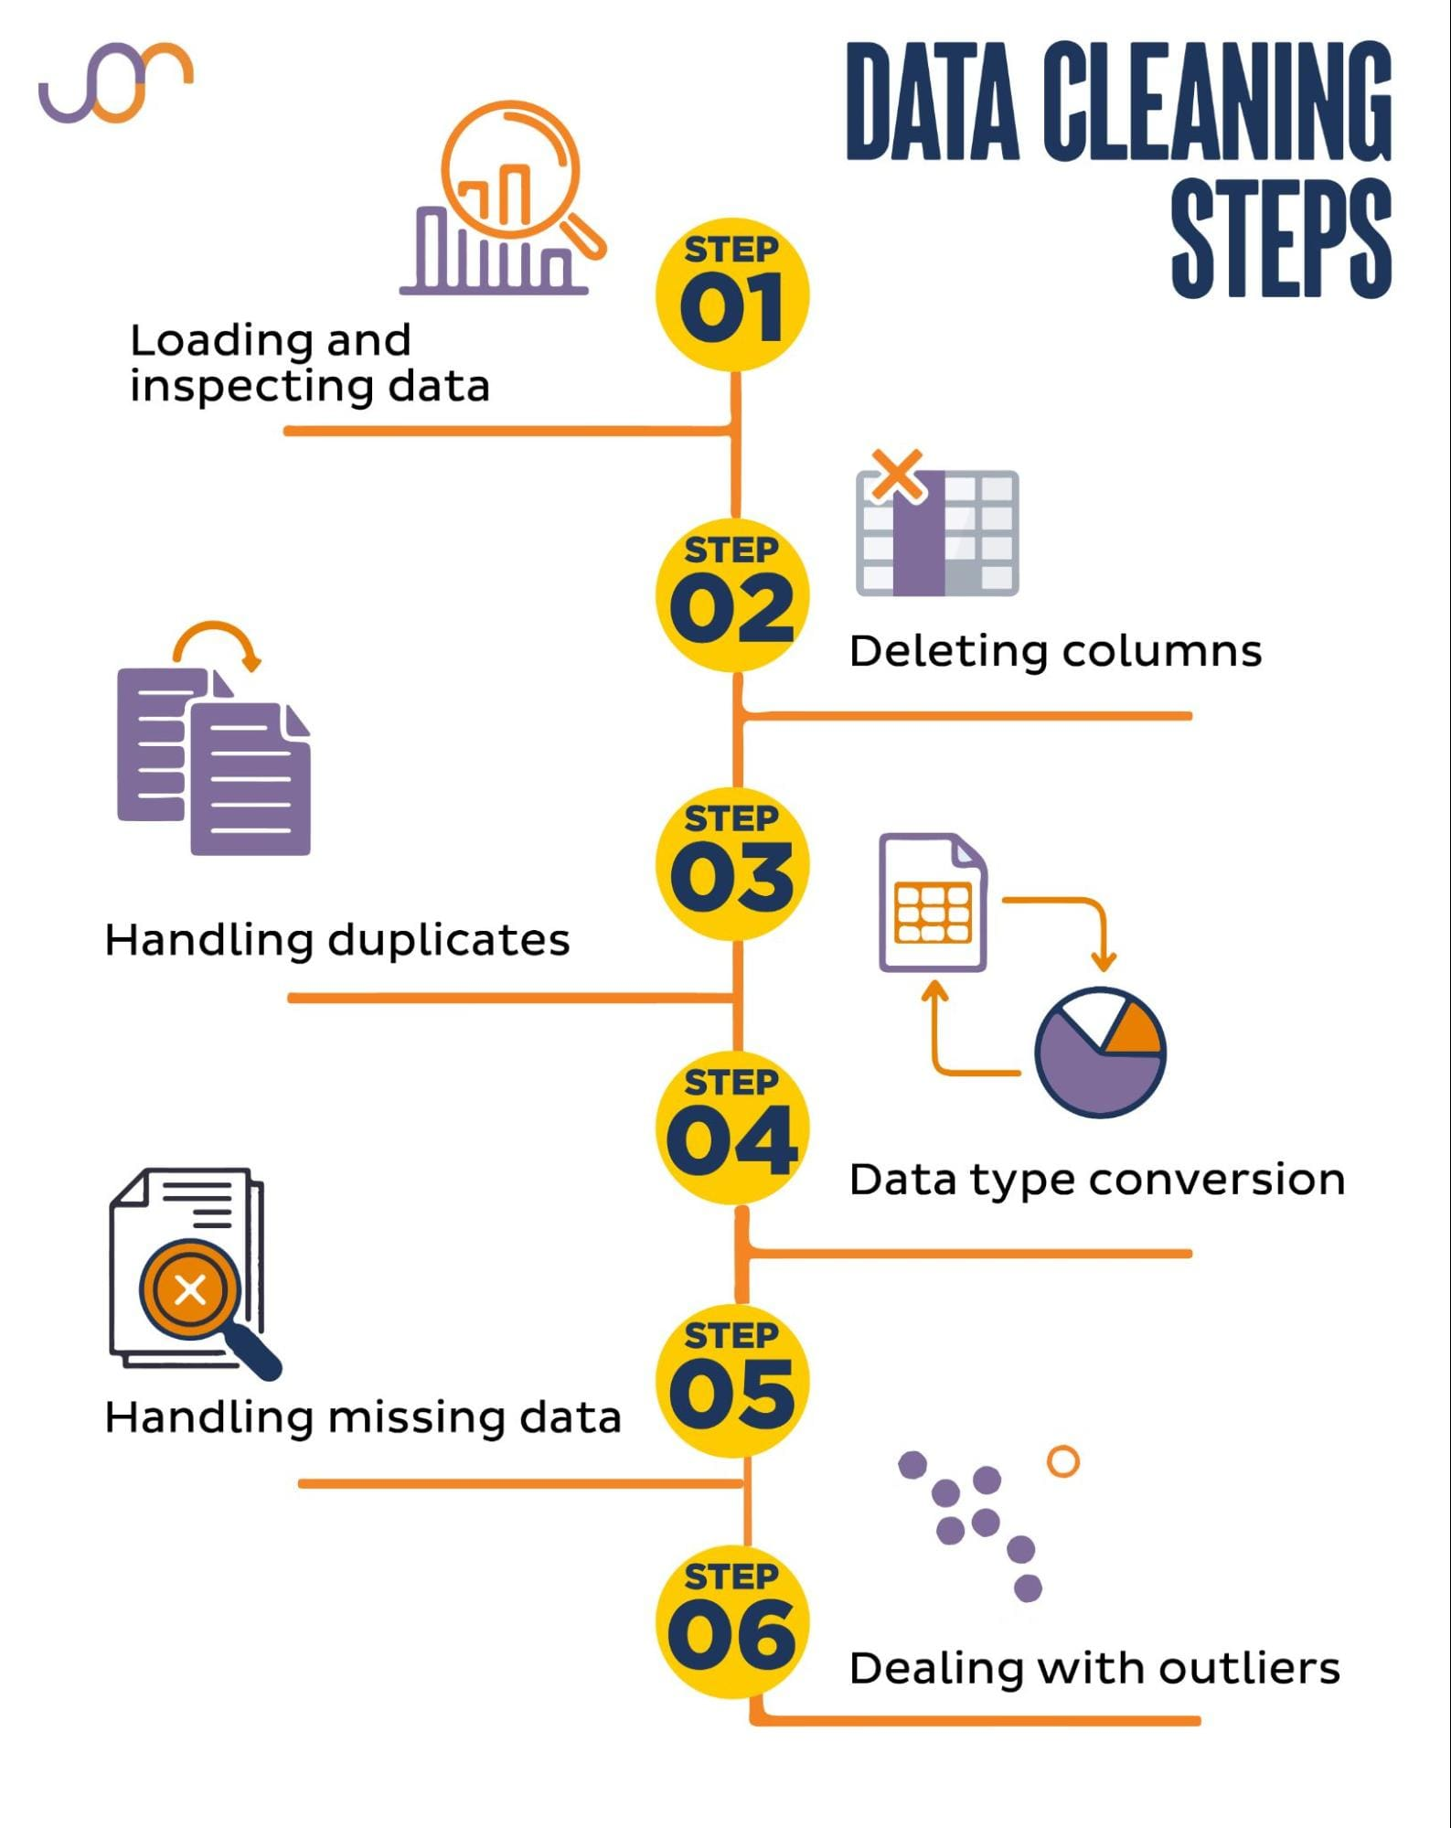
DATA CLEANING
A process of identifying, correcting, and removing errors, inconsistencies, duplicates, or irrelevant entries from a dataset to improve its quality and ensure it is accurate, complete, and usable for analysis.

Slide 12
Practice 2: data cleaning
Data Type Conversation
Text to DateTime
Select Desired Column
Rewrite value for Column

Slide 13
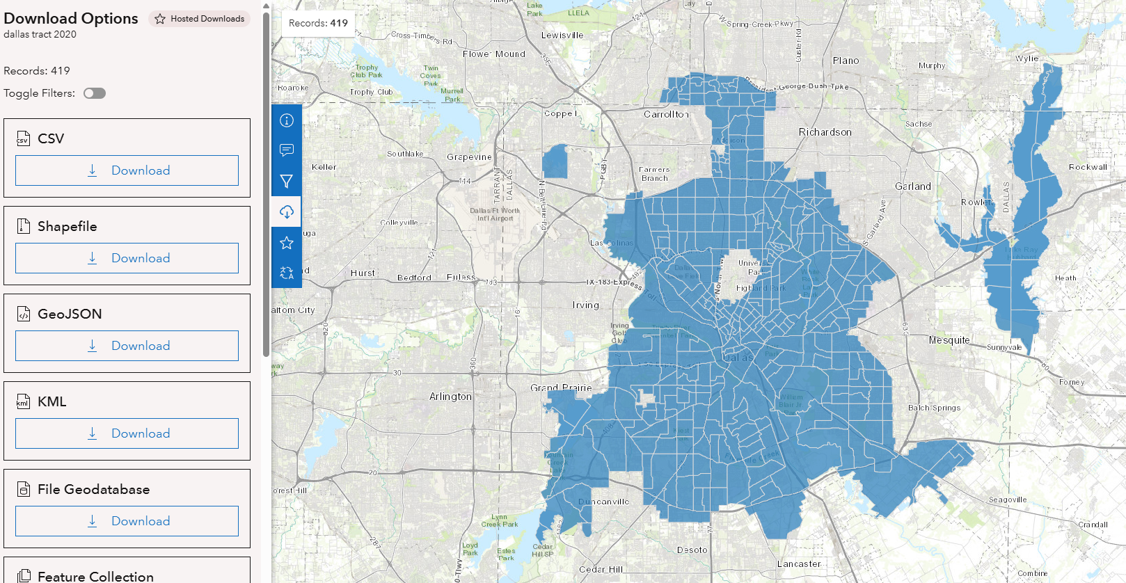
Google colab to google drive

Slide 14
Practice 3
Aggregate points to census tracts
Download census tract from GIS Data Portal
Upload Census Tract Data into Google Drive
Connect Google Colab to Google Drive
Aggregate Points to Census Tracts

Slide 15

Lab Session this Thursday

